Slide 1
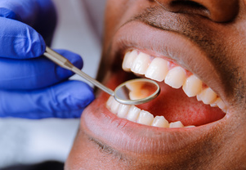
WE ARE HIRING….…
Equitas Health is to be the gateway to good health for those at risk or affected by HIV/AIDS, for our LGBTQ community.
Openings
LPNs – Columbus and Dayton
Dental Assistant – Columbus
Housing Case Manager – Portsmouth
Part Time Hygienist – Columbus
Clinical RN Ops Advisor – Columbus
Pharmacy Technician – Columbus
Please apply
https://equitashealth.com/careers/
Email: pameladiggs@equitashealth.com
MEDICAL
PHARMACY
DENISTRY
SUPPORT SERVICES

